Slide 1





NETWORKS goes to school 2024
Eindhoven University of Technology
Thursday 7th of November
Nicos Starreveld, Koen van den Berk, Jiesen Wang

Slide 2
10-11: Introduction to probability theory, mathematical modelling, and queuing theory
11-12:30: Jiesen Part 1: The M/M/1 mathematical model for a queue
12:30-13:30: Lunch
13:30-14:30: Jiesen part 2: The M/M/1/k mathematical model for a queue
14:30-15:00: break
15:00-16:00: Jiesen part 3: Optimal decisions in queueing systems

Slide 3
NETWORKS
Many real-world phenomena can be phrased in terms of networks.
A network consists of objects with connections between them, and possibly also properties of the objects and their connections.
Road networks and traffic congestion.
Electricity networks and electricity flows.
Network of contacts.
5G telecommunication networks.

Slide 4
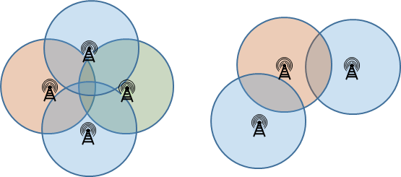
NETWORKS
Many real-world phenomena can be phrased in terms of networks.
A network consists of objects with connections between them, and possibly also properties of the objects and their connections.
5G telecommunication networks.

Slide 5
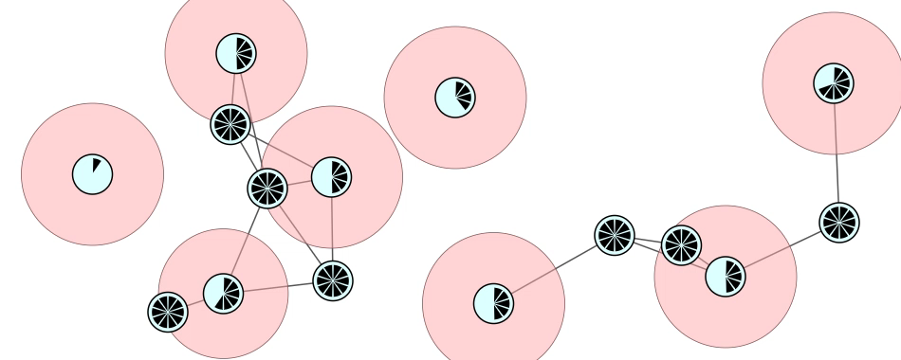
NETWORKS
Many real-world phenomena can be phrased in terms of networks.
A network consists of objects with connections between them, and possibly also properties of the objects and their connections.
5G telecommunication networks.

Slide 6
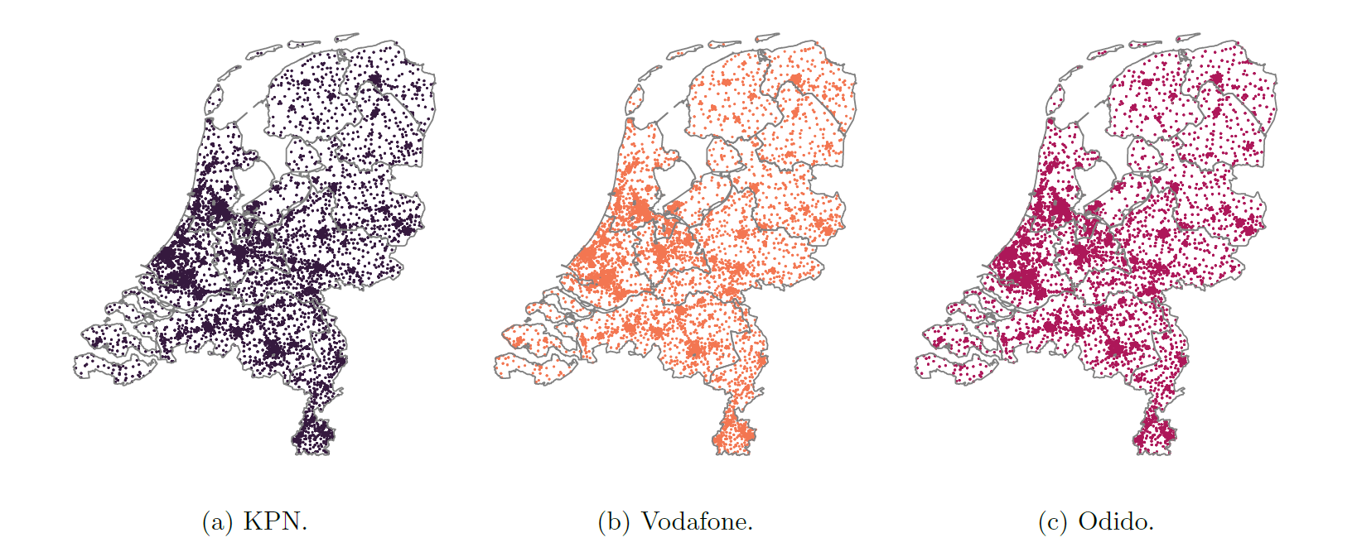
NETWORKS

Slide 7
NETWORKS
Mathematics play an important role in understanding and developing networks.
Fundamental, creative, challenging, applied!
Grath theory (the infrastructure)
Game theory (the decisions)
Probability theory (the randomness) (Today)
Algorithms (how the network works)
Queueing theory (how to optimize what the network is doing) (Today)

Slide 8

Probability theory
Understanding uncertainty

Slide 9
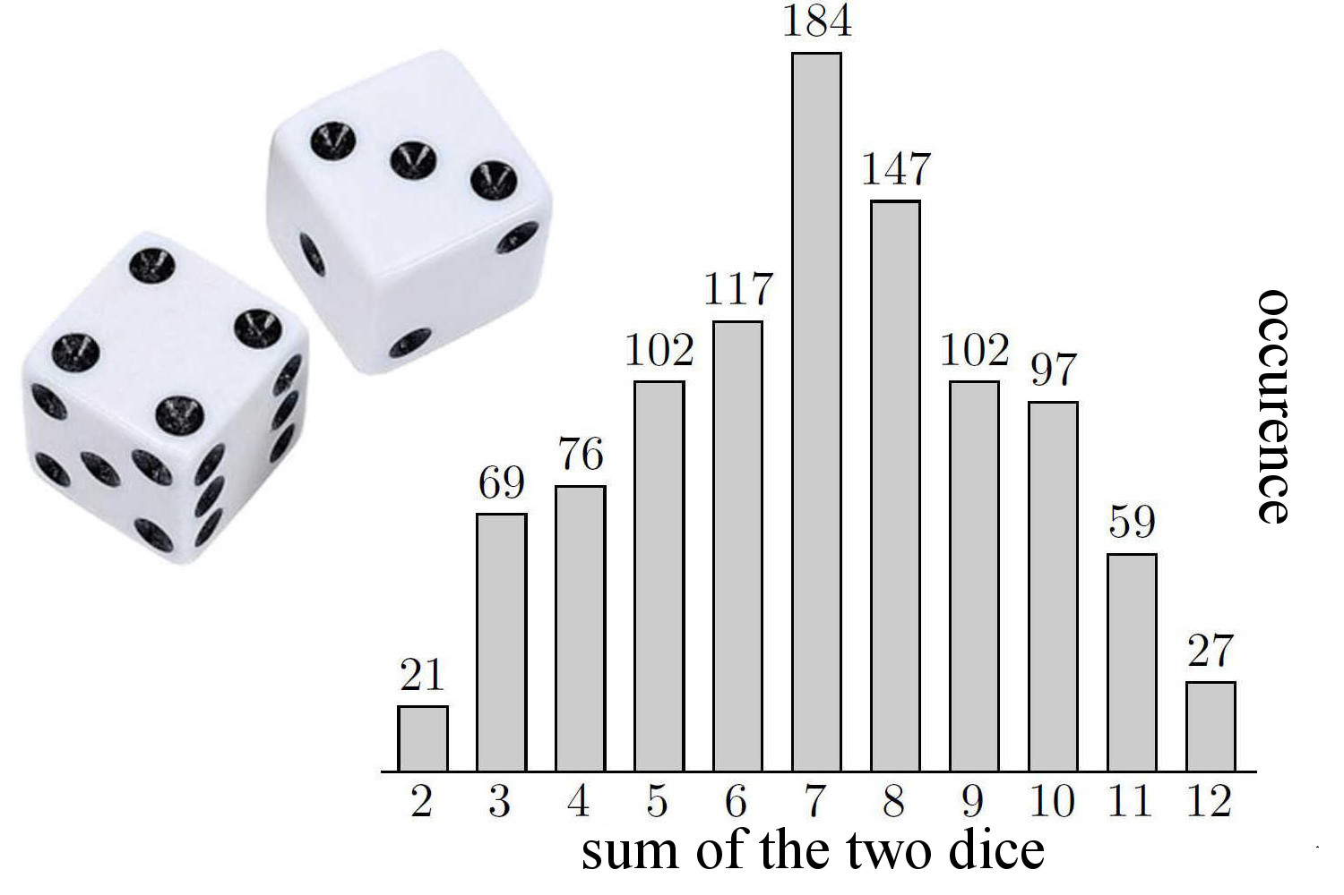
Probability theory
Probability theory is the area of mathematics that studies random phenomena.
If the experiment is tossing a coin, then there are two possible outcomes, either heads or tails. Each outcome occurs with probability 0,5.
In order to study such a random
experiment we use random variables.

Slide 10
Probability theory
A random variable X is a variable whose possible values are outcomes of a random experiment.
We will also use the term stochastic as a synonym for random.

Slide 11
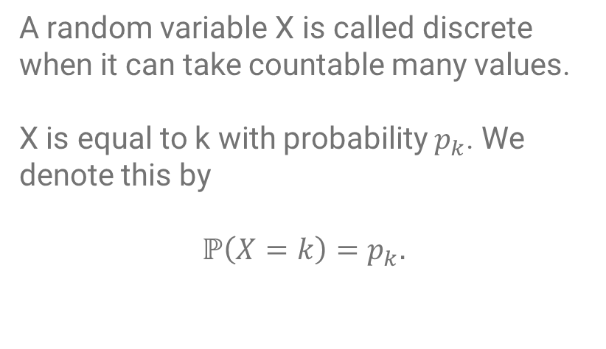
Probability theory
A random variable X is called discrete when it can take countable many values.
X is equal to k with probability $p_{k}$. We denote this by
$$ℙ\left(X=k\right)=p_{k}.$$

Slide 12
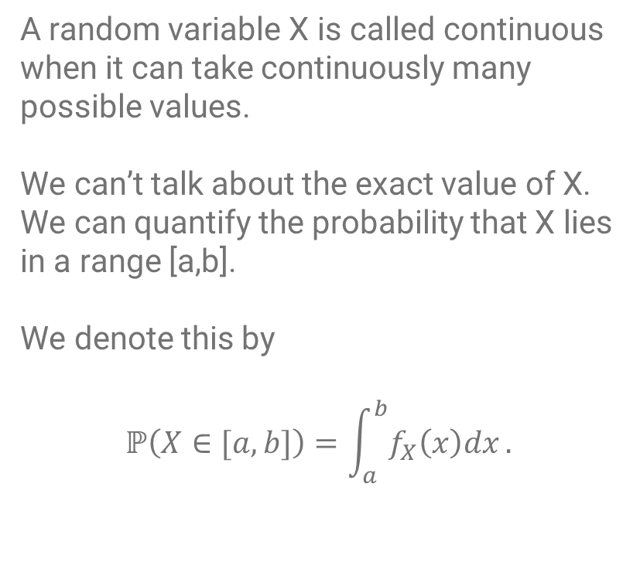
Probability theory
A random variable X is called continuous when it can take continuously many possible values.
We can’t talk about the exact value of X. We can quantify the probability that X lies in a range [a,b].
We denote this by
$$ℙ\left(X∈[a,b]\right)=\int_{a}^{b}{f_{X}\left(x\right)dx}.$$

Slide 13
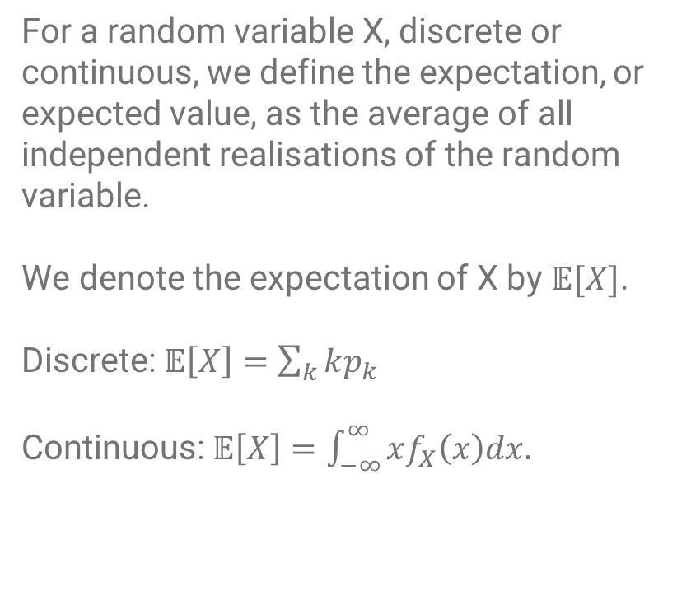
Probability theory
For a random variable X, discrete or continuous, we define the expectation, or expected value, as the average of all independent realisations of the random variable.
We denote the expectation of X by $𝔼[X]$.
Discrete: $𝔼\left[X\right]=\sum_{k}{kp_{k}}$
Continuous: $𝔼\left[X\right]=\int_{−∞}^{∞}{xf_{X}\left(x\right)dx.}$

Slide 14
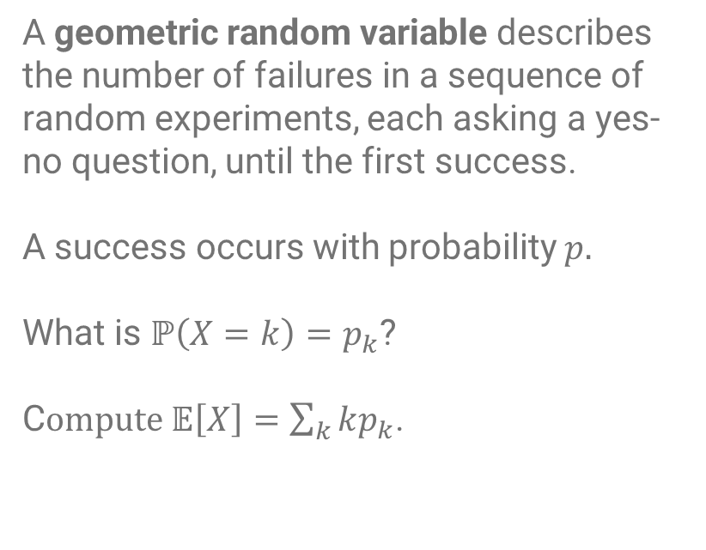
Probability theory – Geometric Random Variable
A geometric random variable describes the number of failures in a sequence of random experiments, each asking a yes-no question, until the first success.
A success occurs with probability $p.$
What is $ℙ\left(X=k\right)=p_{k}$?
C$ompute 𝔼\left[X\right]=\sum_{k}{kp_{k}}$.

Slide 15
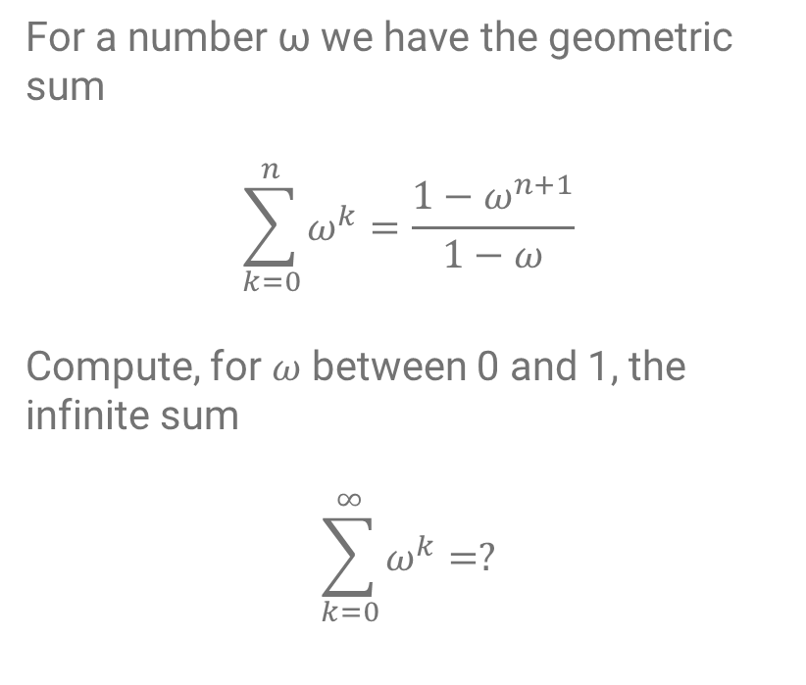
Probability theory – Geometric Sum
For a number ω we have the geometric sum
$$\sum_{k=0}^{n}{ω^{k}}=\frac{1−ω^{n+1}}{1−ω}$$
Compute, for $ω$ between 0 and 1, the infinite sum
$$\sum_{k=0}^{∞}{ω^{k}=?}$$

Slide 16
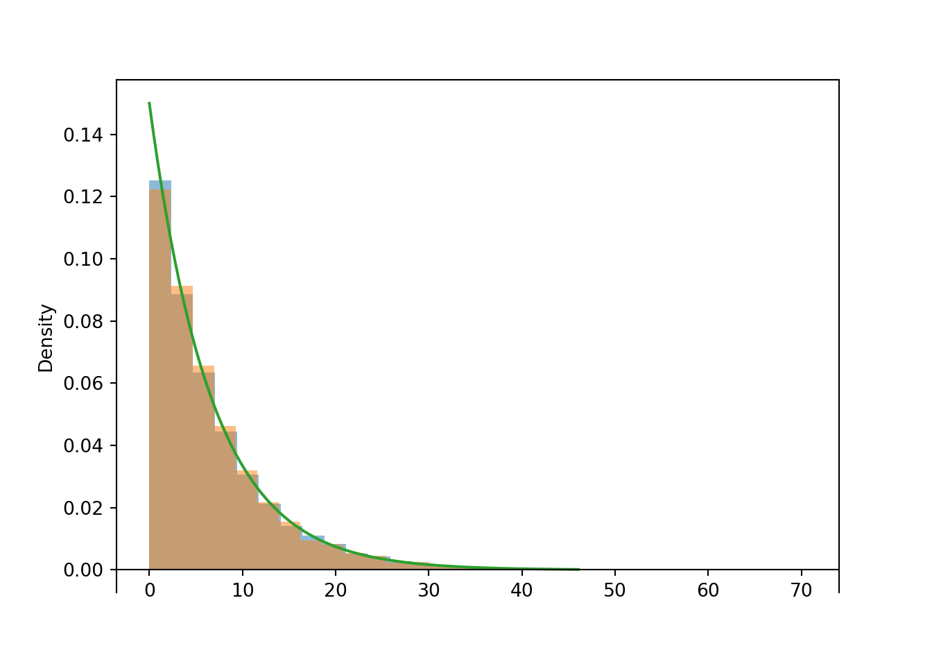
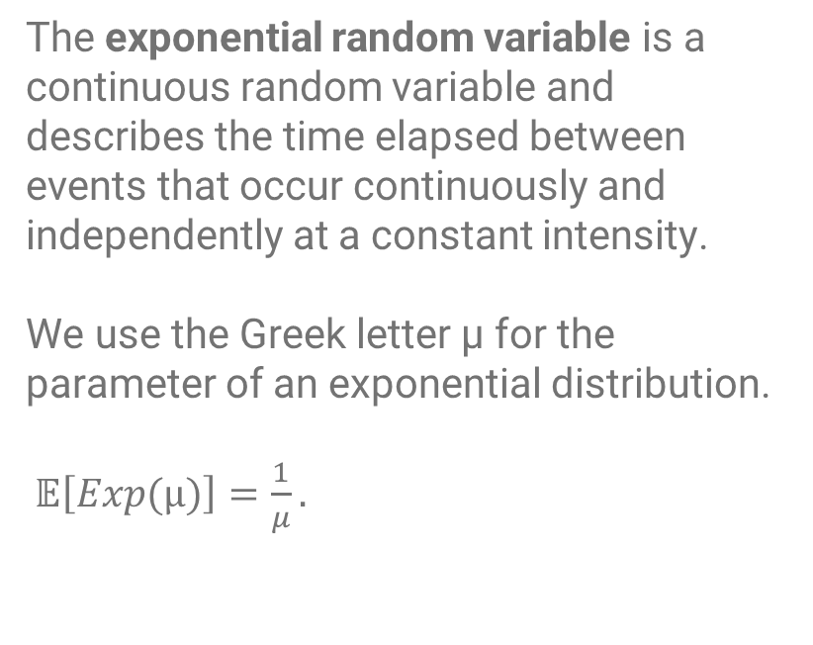
Probability theory – Exponential Random Variable
The exponential random variable is a continuous random variable and describes the time elapsed between events that occur continuously and independently at a constant intensity.
We use the Greek letter μ for the parameter of an exponential distribution.
$𝔼\left[Exp(μ)\right]=\frac{1}{μ}.$

Slide 17
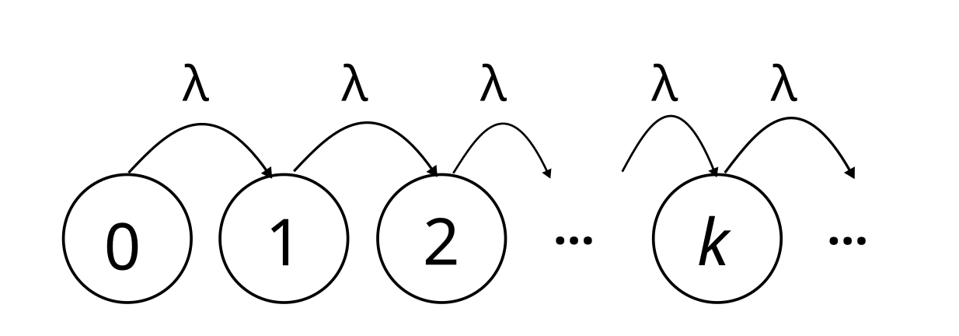
Probability theory – Poisson process
Represents a sequence of events where
events happen once every while.
The time between events is exponentially distributed.
The Poisson process has a very remarkable property. If no event happened for a while, it doesn’t imply that some event will occur soon.
Events occur at a rate λ.

Slide 18
Queueing theory
How to optimize what the network is doing

Slide 19
Mathematical models
When we speak of a mathematical model we mean a description of a system or some real-life situation, in this case a queue, using mathematical concepts.

Slide 20
Queueing model
Ingredients
How customers arrive.
The behaviour of customers.
How customers are served.
The service discipline.
The server capacity.
The waiting room.

Slide 21
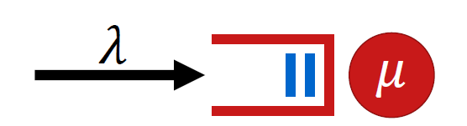
Queueing model
Ingredients
How customers arrive.
The behaviour of customers.
How customers are served.
The service discipline.
The server capacity.
The waiting room.

Slide 22
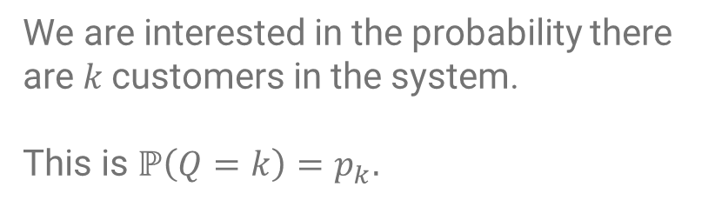
Queueing model – How to analyze it?
We are interested in the probability there are $k$customers in the system.
This is $ℙ\left(Q=k\right)=p_{k}.$

Slide 23
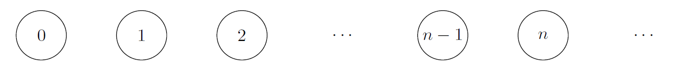
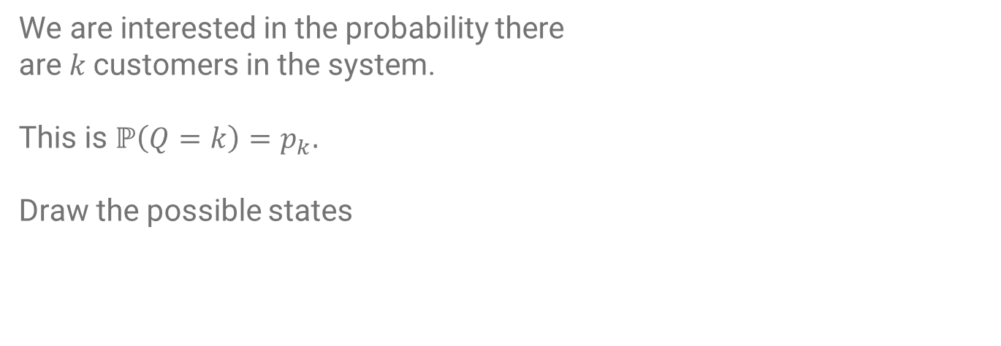
Queueing model – Step 1
We are interested in the probability there
are $k$customers in the system.
This is $ℙ\left(Q=k\right)=p_{k}.$
Draw the possible states

Slide 24
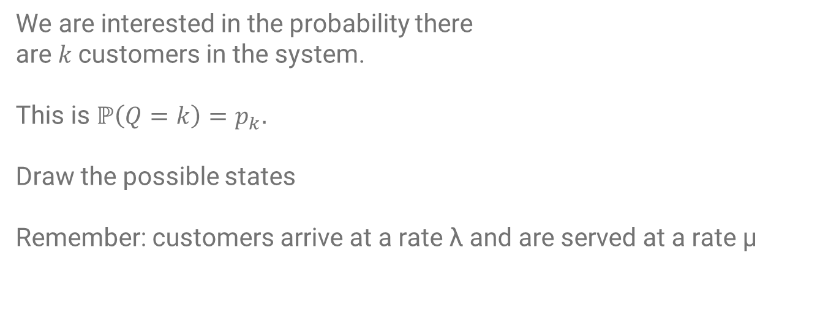
Queueing model – Step 1
We are interested in the probability there
are $k$customers in the system.
This is $ℙ\left(Q=k\right)=p_{k}.$
Draw the possible states
Remember: customers arrive at a rate λ and are served at a rate μ

Slide 25
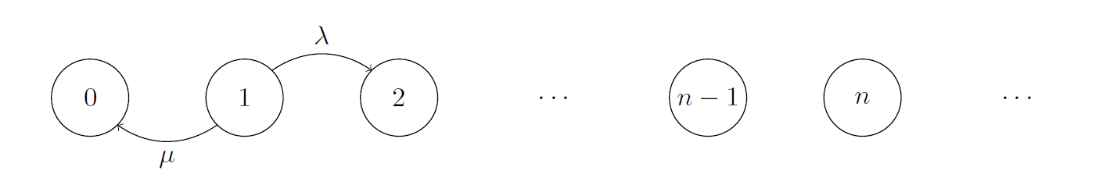
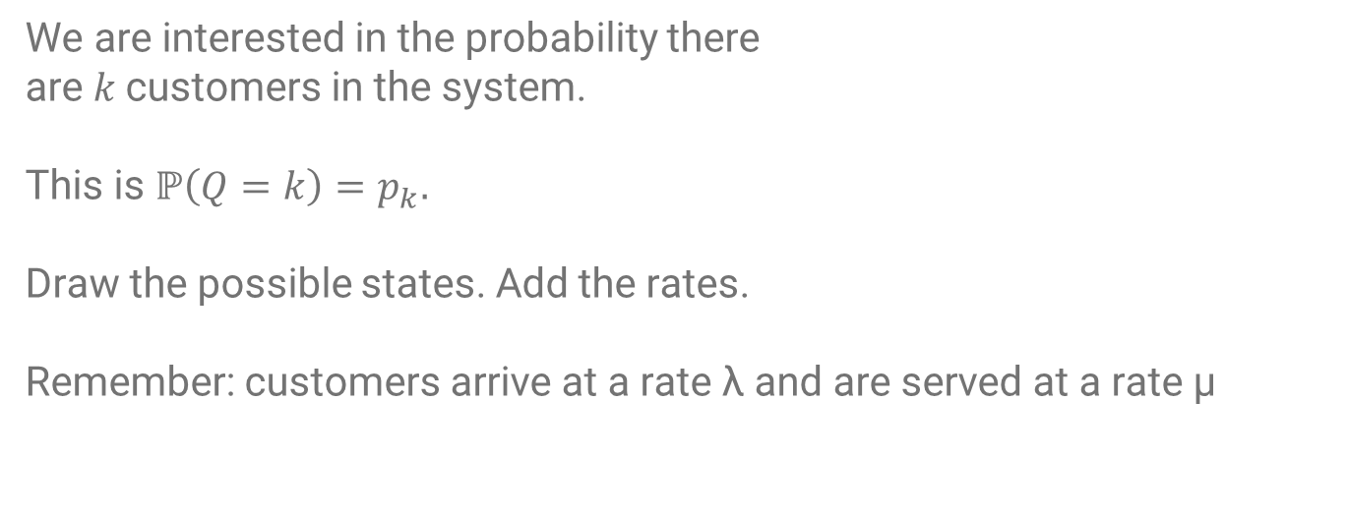
Queueing model – Step 2
We are interested in the probability there
are $k$customers in the system.
This is $ℙ\left(Q=k\right)=p_{k}.$
Draw the possible states. Add the rates.
Remember: customers arrive at a rate λ and are served at a rate μ

Slide 26
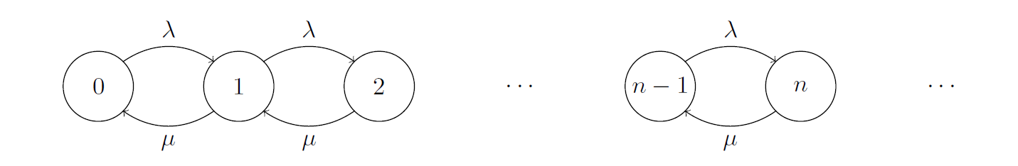
Queueing model – Step 2
We are interested in the probability there
are $k$customers in the system.
This is $ℙ\left(Q=k\right)=p_{k}.$
Draw the possible states. Add the rates.
Remember: customers arrive at a rate λ and are served at a rate μ

Slide 27
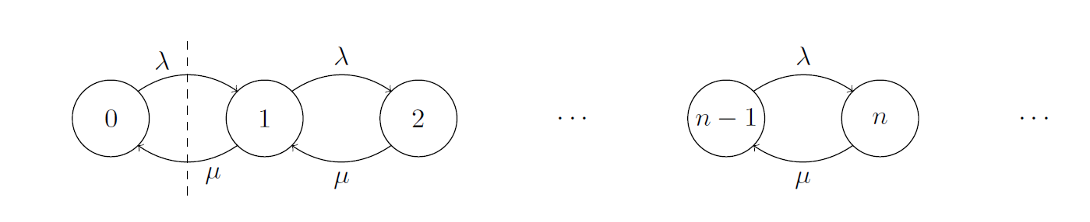
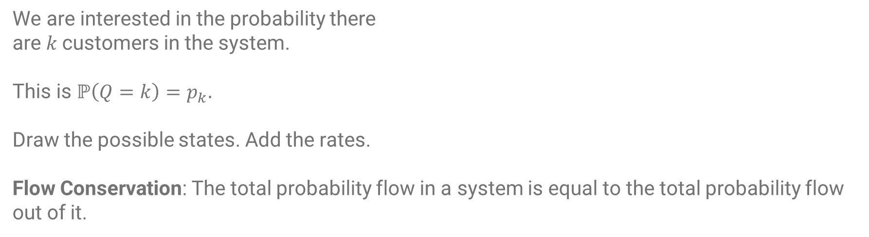
Queueing model – Step 3 Flow Conservation Argument
We are interested in the probability there
are $k$customers in the system.
This is $ℙ\left(Q=k\right)=p_{k}.$
Draw the possible states. Add the rates.
Flow Conservation: The total probability flow in a system is equal to the total probability flow out of it.

Slide 28
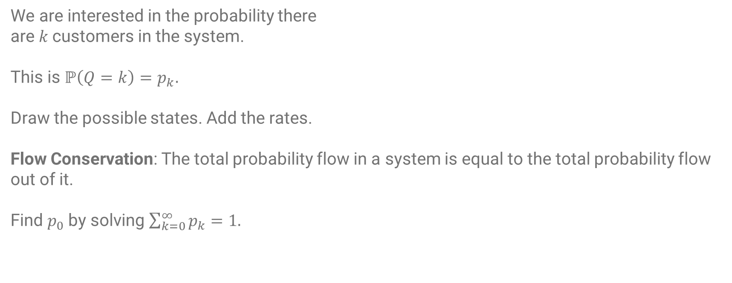
Queueing model – Step 4 Probabilities should add up to 1
We are interested in the probability there
are $k$customers in the system.
This is $ℙ\left(Q=k\right)=p_{k}.$
Draw the possible states. Add the rates.
Flow Conservation: The total probability flow in a system is equal to the total probability flow out of it.
Find $p_{0}$ by solving $\sum_{k=0}^{∞}{p_{k}}=1.$

Slide 29

Queueing model – How to analyze it?
Step 1: Draw the possible states
Step 2: Draw the transitions.
Remember: customers arrive at
a rate λ and are served at a rate μ
Step 3: Use flow conservation argument to derive equations for $p_{k}.$
Step 4: Find $p_{0}$ by solving $\sum_{k=0}^{∞}{p_{k}}=1$.

Slide 30
10-11: Introduction to probability theory, mathematical modelling, and queuing theory
11-12:30: Jiesen Part 1: The M/M/1 mathematical model for a queue
12:30-13:30: Lunch
13:30-14:30: Jiesen part 2: The M/M/1/k mathematical model for a queue
14:30-15:00: break
15:00-16:00: Jiesen part 3: Optimal decisions in queueing systems

Slide 31



What is there for you?
Network Pages: https://www.networkpages.nl/
Educational material (Dutch): www.onderwijs.networkpages.nl
On both websites you can subscribe to a newsletter!
Contact: editor@networkpages.nl, n.j.starreveld@uva.nl

Slide 32
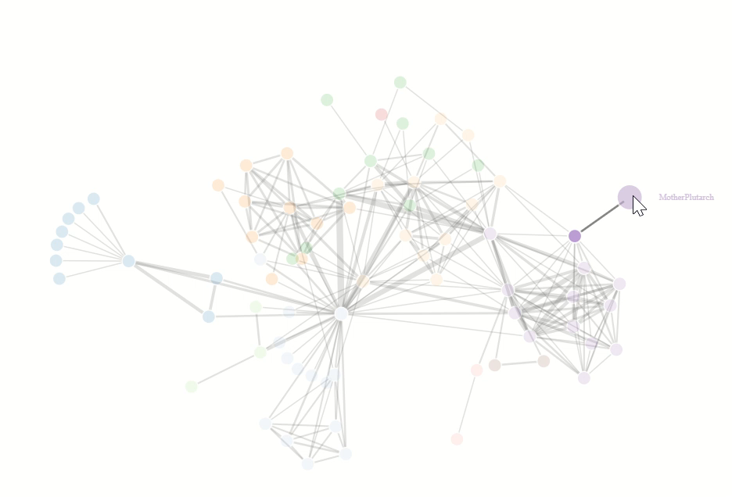
A Dutch version for school pupils
Webclass on Complex Networks
Lecture notes on various topics
Algorithms and Complexity
The mathematics behind AI
The mathematics behind Enigma
The theorem of Descartes
De Bruijn graphs and magic tricks
Colorings of graphs
Programming in Python for school students

